Slide 1
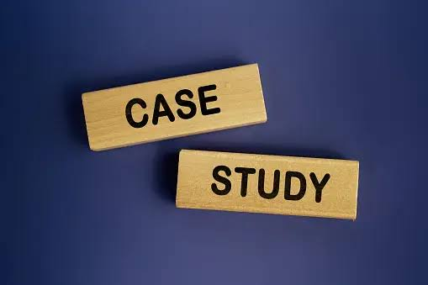
Presented By :-
Kajal Bombarde
Mohammad Sohel
Abhishek Gupta
Sai Charan
Madhav Yawale
Srinivas
The case study is we need to make the food app which is better than existing apps like swiggy & zomato and we have to launched it on the ONDC platform.

Slide 2
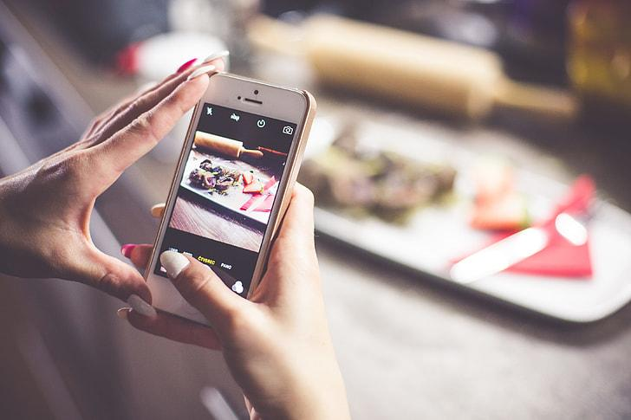
FOODIE BEE

Slide 3
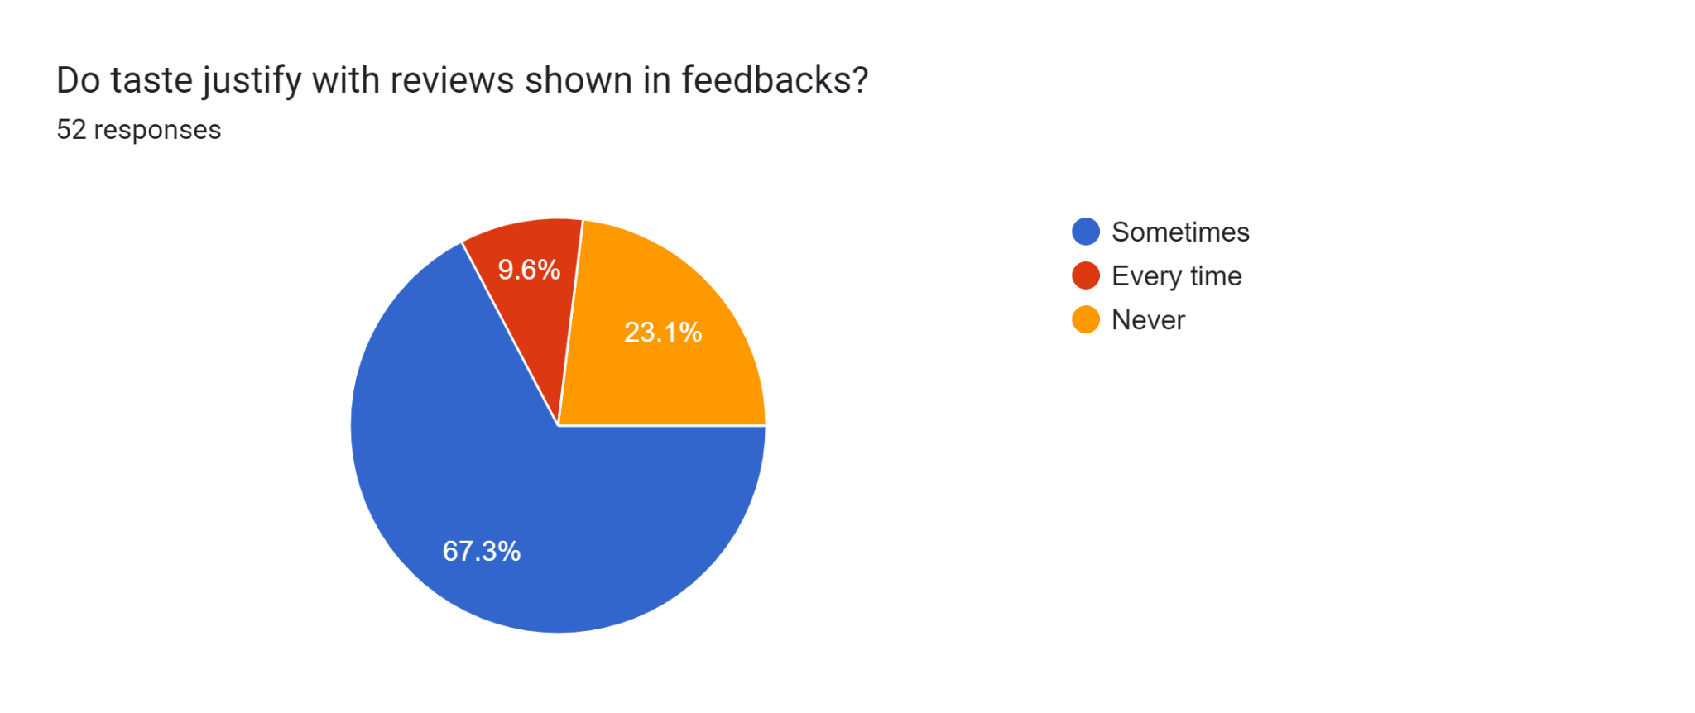
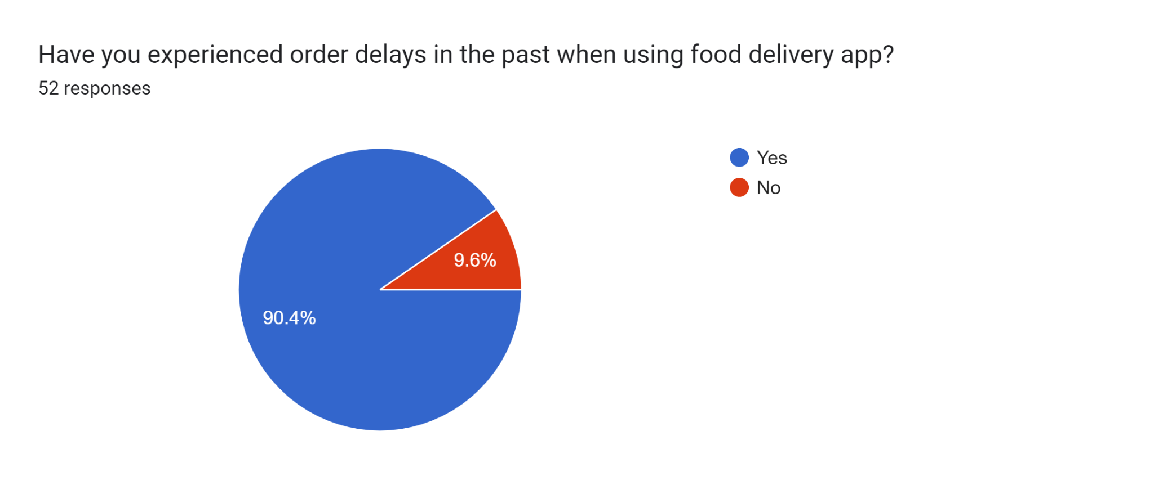
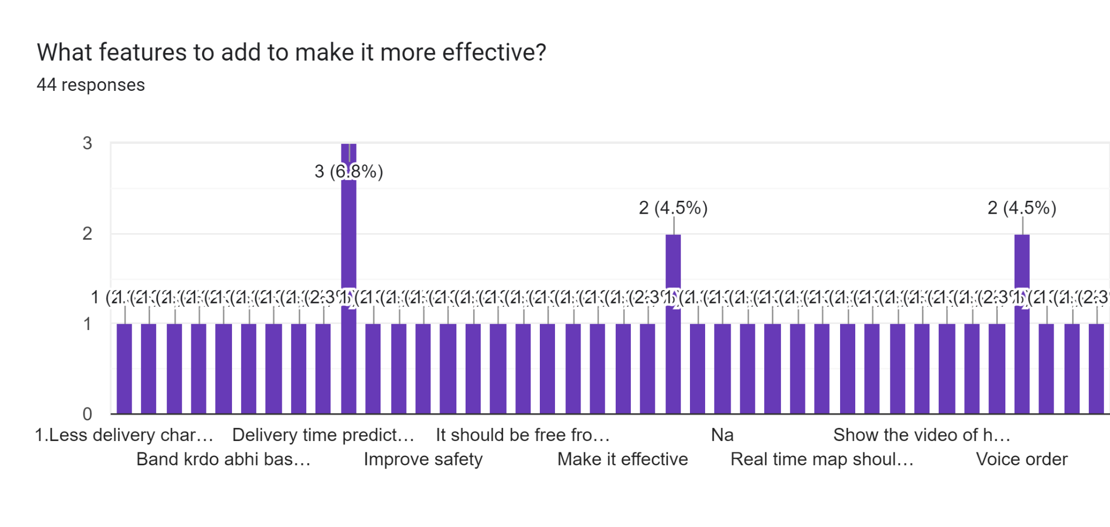
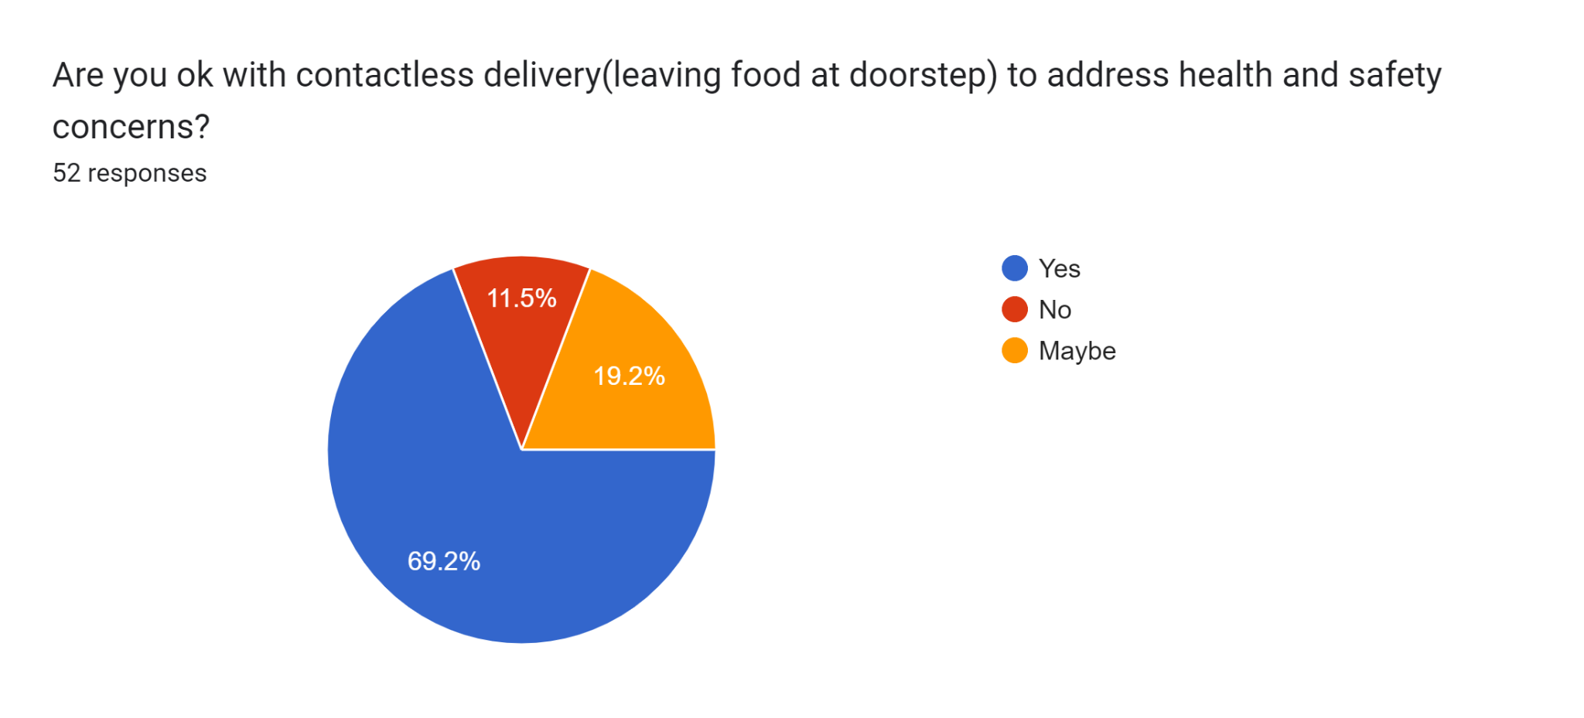
Market Analysis

Slide 4

Problem Statement And Solution
Order Delay - use advanced algo and real-time data
Dining Dilema - Build a foodie community (Community Feature)
Frequent Order Cancellation - Zero-Waste Initiatives
Not feasible for old age community - Voice Order
Prices increased during peak hours - Dynamic Pricing Transparency

Slide 5


Unique Features and How it works …
In app chat support
Community Feature
Subscription Tiers
Zero-Waste Initiatives
Localized Recommendations
Voice Ordering(Implement voice recognition technology to allow users to place orders through voice commands for added convenience)
Diverse Dietary Filters

Slide 6
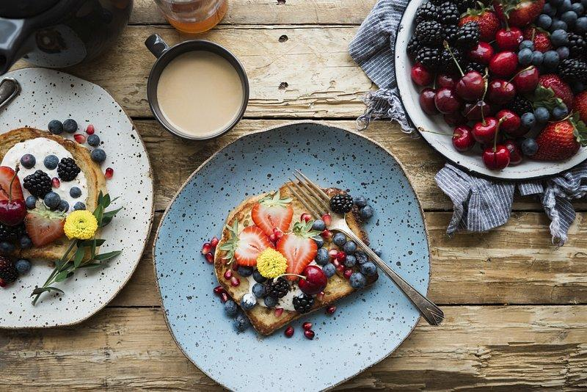
Welcome Beees !!
Get ready to experience revolutionary food delivery app
Let’s get started!

Slide 7
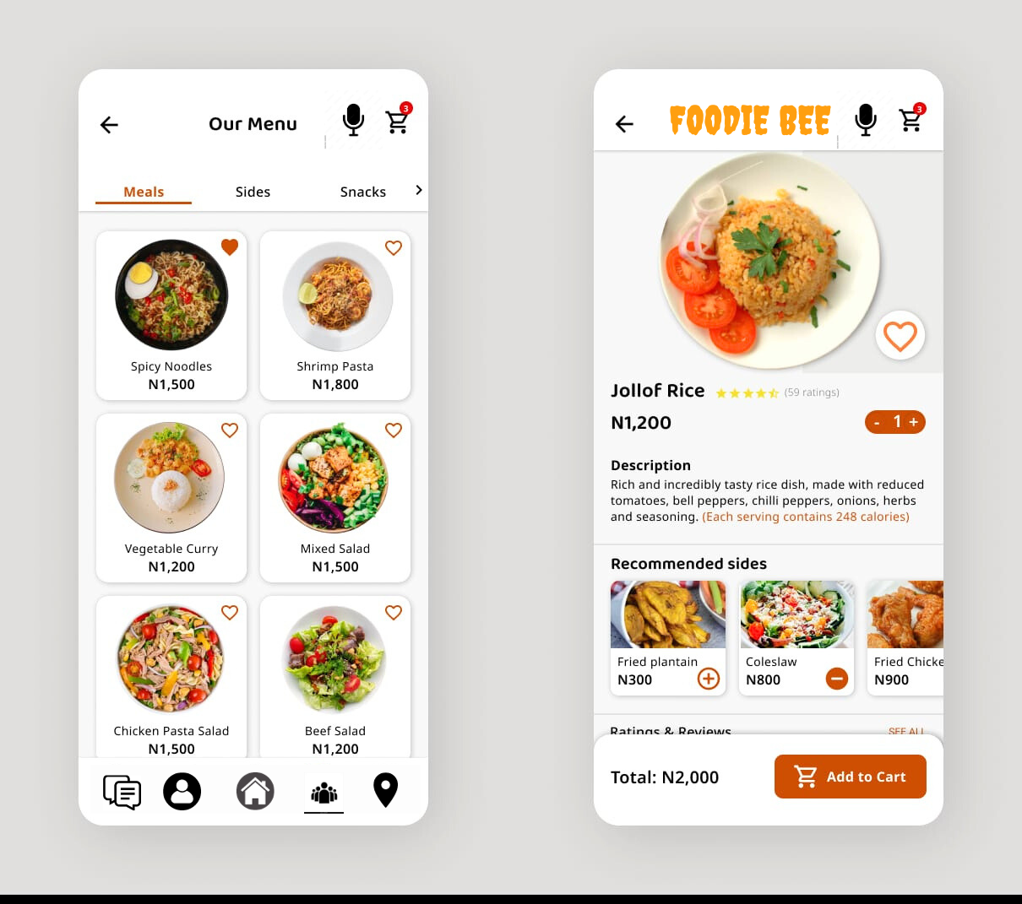
Interface Of The App
Voice Order
Chatbox
Location
Profile
Community

Slide 8

Benefits to Restaurant
Increases Visibility.
Expanded Customer Base.
Increases food Orders.
Brand Recognition and Marketing Strategy
Flexibility

Slide 9

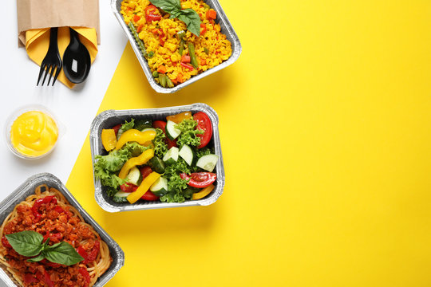
Revenue Model
Subscription Fee
Community Charges

Slide 10

Marketing Strategy
Social media
App store optimization
Email marketing
Branding marketing
Collaborations with food influencers
Affiliate Marketing

Slide 11


